Slide 1
Introduction to Programming with Python

Slide 2
References
http://python.org/
- documentation, tutorials, beginners guide, core distribution, ...
Books include:
Learning Python by Mark Lutz
Python Essential Reference by David Beazley
Python Cookbook, ed. by Martelli, Ravenscroft and Ascher
(online at http://code.activestate.com/recipes/langs/python/)
http://wiki.python.org/moin/PythonBooks
Videos:
http://showmedo.com/videotutorials/python
“5 Minute Overview (What Does Python Look Like?)”
“Introducing the PyDev IDE for Eclipse”
“Linear Algebra with Numpy”

Slide 3

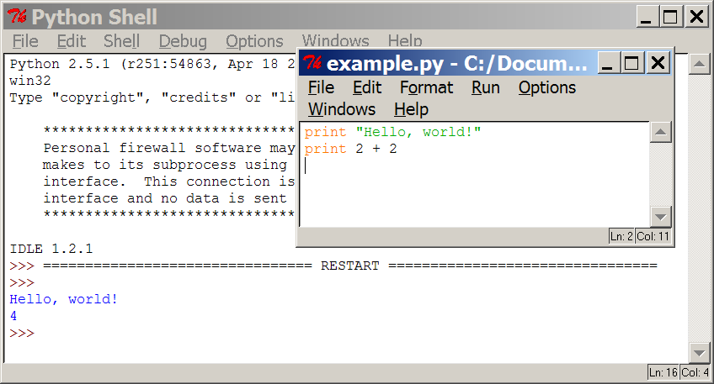
Programming basics
code or source code: The sequence of instructions in a program.
syntax: The set of legal structures and commands that can be used in a particular programming language.
output: The messages printed to the user by a program.
console: The text box onto which output is printed.
  Some source code editors pop up the console as an external window, and others contain their own console window.

Slide 4
Python Concepts
1. Dynamic v/s static types
Ex: >>>6.0 / 2
3 .0
2. Interpreted v/s compiled
Python generates byte codes-cross-platform and portability of code
3. Prototyping
Rapid application development and program prototyping.
4. Procedural v/s Object-Oriented Programming

Slide 5



Compiling and interpreting
Many languages require you to compile (translate) your program into a form that the machine understands.
Python is instead directly interpreted into machine instructions.
compile
execute
source code
Hello.java
byte code
Hello.class
output
interpret
source code
Hello.py
output

Slide 6
Comparison of Programming Languages
C
C++
C#
Java
Python

Slide 7
The Python Interpreter
Windows:
1. Open the Start menu.
2. Click on “Run. . . ”
3. Type “cmd” in the text box (without the quotes) and hit Return.
4. You should now have a black window with white text. This is
the command prompt.
5. If you type “python” at the prompt, you should be dropped into
the Python interpreter prompt.
Python 2 . 5 . 1 ( r251 :54863 , Jan 17 2008 , 1 9 : 3 5 : 1 7 )
[GCC 4 . 0 . 1 (Apple Inc . bui ld 5465) ] on darwin
Type " help " , " copyr ight " , " c r e d i t s " or " l i c ense "
for more informat ion .
>>>

Slide 8
Python Versions
Python 2.x
Python 3.x

Slide 9
Using the Python Command Prompt
You can type things directly into a running Python session
>>> 2+3*4
14
>>> name = "Andrew"
>>> name
'Andrew‘
>>> print "Hello", name
Hello Andrew
>>>5**2
25

Slide 10
Commenting Python
>>>d i c t = {" First phonetic " : "Able" , " Second phonetic " : "Baker"} #create a dictionary
>>>print dict.keys ( ) #dictionary values aren’t in order
[ ’Second phonetic ’ , ’First phonetic ’ ]
>>>print dict [ "First phonetic " ] #print the key’s value
Able

Slide 11
Launching Python Programs
$python filename.py
Files saved with the .py extension are called modules and can be called individually at the command line or within a program, similar to header files in other languages. If your program is going to import other modules, you will need to make sure they are all saved in the same directory on the computer.
$python filename.py −f
The “-f” argument is received by the program and calls a function that prints the data to a designated location within the computer’s file system instead of printing it to the screen.

Slide 12
Integrated Development Environments (IDE)
1. PyDev with Eclipse
2. Komodo
3.Emacs
4. Vim
5. TextMate
6. Gedit
7. Idle
8. PIDA (Linux)(VIM Based)
9. NotePad++ (Windows)
10.BlueFish (Linux)

Slide 13
Common Python IDEs
Eric-a free application that acts as a front-end to other programs
and uses plug-ins.
IDLE-a free application included in the base Python installation;
includes an integrated debugger.
Komodo-a full-featured, proprietary application that can be used
for other programming languages.
PyDev-a plug-in for the Eclipse development environment.

Slide 14
Types and Operators
Python syntax
Indentation:
1 x = 1
2 if x : #if x is true
3 y=2
4 if y : #i f y is true
5 print "block 2"
6 print "block 1"
7 else : print "block 0"

Slide 15
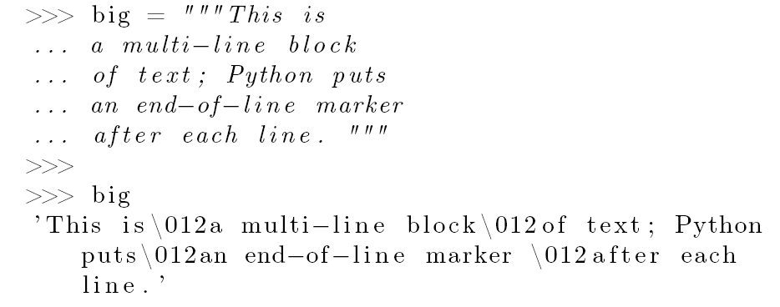
Python syntax
Multiple Line Spanning

Slide 16
Python syntax
Python Object Types
Built-in Types are:
Numbers
Strings
Lists
Dictionaries
Tuples
Files.

Slide 17
Python Numbers
integer: 12345, -32
Python integer: 999999999L (In Python 3.x, all integers are
Python integers)
float: 1.23, 4e5, 3e-4
octal: 012, 0456
hex: 0xf34, 0X12FA
complex: 3+4j, 2J, 5.0+2.5j

Slide 18
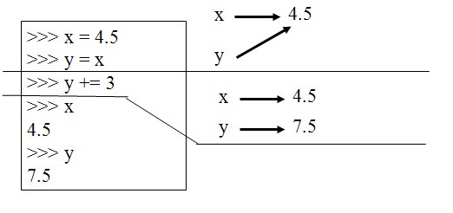
Python Numbers
Numbers are immutable

Slide 19
Python Integers
Integer – the equivalent of a C long.
Long Integer – an unbounded integer value.
>>> 132224
132224
>>> 132323 ** 2
17509376329L
>>>

Slide 20
Python float
int(x) converts x to an integer
float(x) converts x to a floating point
The interpreter shows a lot of digits
>>> 1.23232
1.2323200000000001
>>> print 1.23232
1.23232
>>> 1.3E7
13000000.0
>>> int(2.0)
2
>>> float(2)
2.0

Slide 21
Complex types
Built into Python
Same operations are supported as integer and float
>>> x = 3 + 2j
>>> y = -1j
>>> x + y
(3+1j)
>>> x * y
(2-3j)

Slide 22
Arithmetic Operators
expression: A data value or set of operations to compute a value.
  Examples: 1 + 4 * 3
  42
Arithmetic operators we will use:
  + - * / addition, subtraction/negation, multiplication, division
  % modulus, a.k.a. remainder
  ** exponentiation
precedence: Order in which operations are computed.
  * / % ** have a higher precedence than + -
  1 + 3 * 4 is 13
  Parentheses can be used to force a certain order of evaluation.
  (1 + 3) * 4 is 16

Slide 23
Strings
s1 = ‘ ’ : empty string
s2 = “knight’s” : double quotes
block = “““ - ” ” ” : triple-quoted block
s1 + s2 : concatenate (combine)
s2 * 3 : repeat the string a certain number of times
s2[n] : index (the position of a certain character)
len(s2) : get the length of a string
“a %s parrot” % ‘dead’ : string formatting (deprecated in Python
3.x)
“a {0} parrot”.format(“dead”) : string formatting (Python 3.x)
for x in s2 : iteration (sequentially move through the string’s
characters)
‘m’ in s2 : membership (is there a given character in the string?)

Slide 24
String Literals
Can use single or double quotes, and three double quotes for a multi-line string
>>> 'I am a string'
'I am a string'
>>> "So am I!"
'So am I!'
>>> s = """And me too!
though I am much longer
than the others :)"""
'And me too!\nthough I am much longer\nthan the others :)‘
>>> print s
And me too!
though I am much longer
than the others :)‘

Slide 25
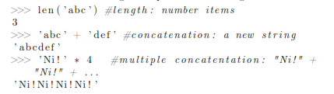
Concatenation of strings
Strings are immutable
There is no char type like in C++ or Java
+ is overloaded to do concatenation
>>> x = 'hello'
>>> x = x + ' there'
>>> x
'hello there'

Slide 26
String Operations
Casting number to a string
>>> str(5)
Iteration through a string:
>>> mycollege=‘BMSCE’
>>> for i in myjob:
print(i)
>>> “S” in myjob
1 (Return value means True)

Slide 27
Indexing and Slicing Operations
>>> s=“BMS college of Engineering”
>>> s[0] Indexing from front
B
>>>s[-2] Indexing from rear
n
>>>s[1:3]
MS Range from 1 to 3 excluding 3
>>>s[2: ]
>>>s[ :-1]

Slide 28
String Formatting
>>> s=‘parrot’
>>> d=1
>>> print ‘That is %d dead %s’ %(d,s)
That is 1 dead parrot

Slide 29
String Utilities
>>> import string
>>> s=“COMPUTER SCIENCE”
>>> string.lower(s)
computer science
>>> string.find(s, “SC”)
9
>>>string.atoi(“42”)
42
>>>string.split(s, “COMPUTER”)
[‘ ‘, ‘ SCIENCE’]
>>>string.join (string.split(s, “COMPUTER”), “INFORMATION”)
INFORMATION SCIENCE
>>> len(s)
16

Slide 30
String utilities
>>> s=“PROGRAMMING IN PYTHON”
>>> print (len(s))
21
>>> len(“PROGRAMMING IN PYTHON”)
21

Slide 31
Combining and Separating Strings
Joining strings:
>>>S1=“COMPUTER”
>>>S2=“SCIENCE”
>>>S3=S2.join(S1)
>>>print(S3)
Result???
Join or concatenation which is better??

Slide 32
Combining and Separating Strings
Splitting strings:
>>>s1=“BMS College of Engineering”
>>>s1.split()
[‘BMS’, ‘College’, ‘of’, ‘Engineering’]
>>>s2=“1,2,3,4”
>>>s2.split(‘,’)
[‘1’, ‘2’, ‘3’, ‘4’]

Slide 33
LISTS
>>> list1=[1,2,3,4,5,6]
>>>print(list1)
[1,2,3,4,5,6]
>>> print(list1[0])
1
>>>list1.pop()
6
>>> print(list)
[1,2,3,4,5]

Slide 34
List Usage
Iterating through a list
L1=[“one, “two”, “three, “four”]
for i in L1:
print(“Number” + i)
Number one
Number two
Number three
Number four

Slide 35
List Usage
2.Adding list elements
>>>L1=[1,2,3,4,5]
>>>L1.append(6)
>>>L1
[1,2,3,4,5,6]
>>>L1.insert(1,20)
>>>L1
[1,20,2,3,4,5,6]
>>>L1.sort()
>>>L1
[1,2,3,4,5,6,20]

Slide 36
List Usage
>>>L1=[1,2,3,4,5]
>>>L2=[20,30,40]
>>>L1.extend(L2)
>>>L1
[1,2,3,4,5,20,30,40]
Extend versus append
>>>list1=[1,2,3]
>>> list2=[4,5,6]
>>> list1.extend(list2)
>>> list1
[1,2,3,4,5,6]
>>>len(list1)
6
>>>list1[-1]
6
Extend versus append
>>>list1=[1,2,3]
>>> list2=[4,5,6]
>>> list1.append(list2)
>>> list1
[1,2,3,[4,5,6]]
>>>len(list1)
4
>>>list1[-1]
[4,5,6]

Slide 37
List Usage
3. Mutability:
Changing a list:
>>> list1=[‘bread’, ‘jam’, ‘butter’]
>>>list1[1]=‘bun’
>>>list1
[‘bread’, ’bun’, ’butter’]
>>>list1[0:2]=[‘biscuit’, ‘cookies’]
>>>list1
[‘biscuit’, ‘cookies’, ‘butter’]
>>>del list1[0]
>>> list1
[‘cookies’, ‘butter’]
>>>del list1[1: ]
[‘cookies’]

Slide 38
List Usage
4. Methods
>>> list1=[1,2,3,4,5]
>>> list1.append(10)
>>>lis1.sort()
>>>l ist1.reverse()
>>> list1.index(4)
Repeat:
>>>list1*3
>>>list2=[20,30]
Concatenate:
>>>list1+list2
>>>import os
>>>os.system('cls')

Slide 39
DICTIONARIES
1. Accessed by keyword, not an oﬀset. Dictionaries are similar to associative arrays. Each item in the dictionary has a corresponding keyword; the keyword is used to “call” the item.
2. Stored objects are in a random order to provide faster lookup. When created, a dictionary stores items in any order it chooses. To get a value, simply supply the key. If you need to order the items within a dictionary, you have to do it yourself; there are no built-in methods for it.
3. Dictionaries are variable length, can hold objects of any type (including other dictionaries), and support deep nesting (multiple levels of items can be in a dictionary, such as a list within a dictionary within another dictionary).
4. Implemented as a hash table.

Slide 40
Making a Dictionary
Syntax:
>>> dict1={“key name” : “value”}
>>> dict1={“bread”: “jam”, 1: “cookies”, 2: [‘bun’, ‘butter’]}

Slide 41
Basic Operations
>>> d1={1: 40, “name”: “BMSCE”, 2: “Python”, 50: “ABC”}
>>>d1[“name”] Key works as index here
BMSCE
>>>len(d1)
3
>>>di.haskey(1)
1
>>>d1.keys()

Slide 42
Modifying Dictionaries
>>> d1={1: 40, “name”: “BMSCE”, 2: “Python”, 50: “ABC”}
>>>d1[“name”]=[“bread”, “jam”, butter”]
>>> del d1[2]
>>>d1[30]=“Computer Science”
>>>d1[1]=“Computer Science”
Nested Dictionaries

Slide 43
Tuples
Stores heterogeneous data.
Immutable- so genrally generally used to store different data about a certain thing.
Advantages of using a tuple:
1. Processed faster than lists- when the number of items are fixed.
2. Items are protected from modification-so no risk of accidental change of values.
3. Used for string formatting
4. Can be used as keys in dictionaries

Slide 44
Packing and Unpacking of tuples
>>> tuple=(1,2,3,4,5,6) Packing
>>> first, second, third, fourth, fifth, sixth=tuple Unpacking
>>> second
2
This allows for in-variable swapping
>>> s1=“BMSCE”
>>>s2=“Computer Science”
>>>s1, s2=s2, s1
>>>s1
Computer Science
>>>s2
BMSCE

Slide 45
Operations on Tuples
Indexing
Slicing
Concatenation- + operator
Repititon- * operator
list() function can be used to convert a tuple to a list
tuple() function can be used to convert the list back to a tuple

Slide 46
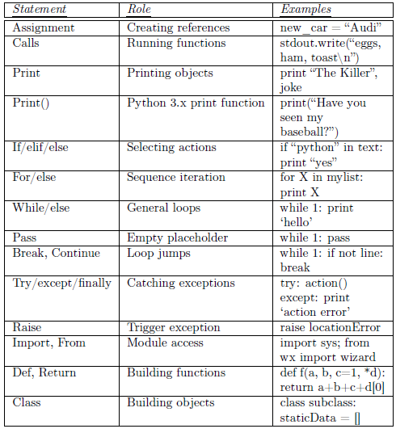
Statements

Slide 47
Assignment
Creates object references
Acts like pointers in C
Names are created when first assigned – no need to pre declare
Sometimes declare and give an empty holder- in case of gloabl assignments
>>> a=“BMSCE”
>>>a=b=“BMSCE”
>>>(a, b=“BMSCE, “CSE”)
>>>[a,b=[“BMSCE”, “CSE]
Values of the varibales are not fixed.

Slide 48
Expressions/Calls
Fucntion call using paranthesis
Method call using dot operator
Interactive print
Compound expression
Range test
Printing: print() function

Slide 49
If Tests and while Loops
if Statement
If and Else-if and Else statements
No switch statement
While Loops:
while <test> :
<Set of statements>
else:
<Set of statements>
break
Break statements simply force the loop to quit early; when used with nested loops, it only exits the smallest enclosing loop.
Continue statements cause the loop to start over, regardless of any other statements further on in the loop.

Slide 50
For Loops
for <target> in <object>:
<set of ststements>
Using range fucntion:
range(5)
range(3,6)
range(0,20,5)

Slide 51
Other statements
Pass Statement- continues without stopping
Break and continue statements
Try, except, finally and raise statements
Import and from statements
def and return statements
Class statements

Slide 52
Files
Files are a way to store data permanently
Treated as data streams
Operations on files:
1.Creating a file:
Myfile=open(‘myfile’, ‘w’)
Modes :
a – Appends all the output to the end of the file
r- Read only
r+ - input and output mode
w – Output mode for writing
w+ - input and output mode-file is overwritten if it already exists
ab, rb, r+b, wb, w+b – for binary files

Slide 53
Reading from a file
Three functions: read(N), readline(), readlines()
If file doesn’t exist, an error is caused.
f=open(“myfile”,”w”)
f.write(“.......................”)
f.close()
try:
f=open(“myfile”,”r”)
f.readlines()
f.close()
except IOError:
print(“File does not exist”)

Slide 54

Iterating through files

